Slide 1
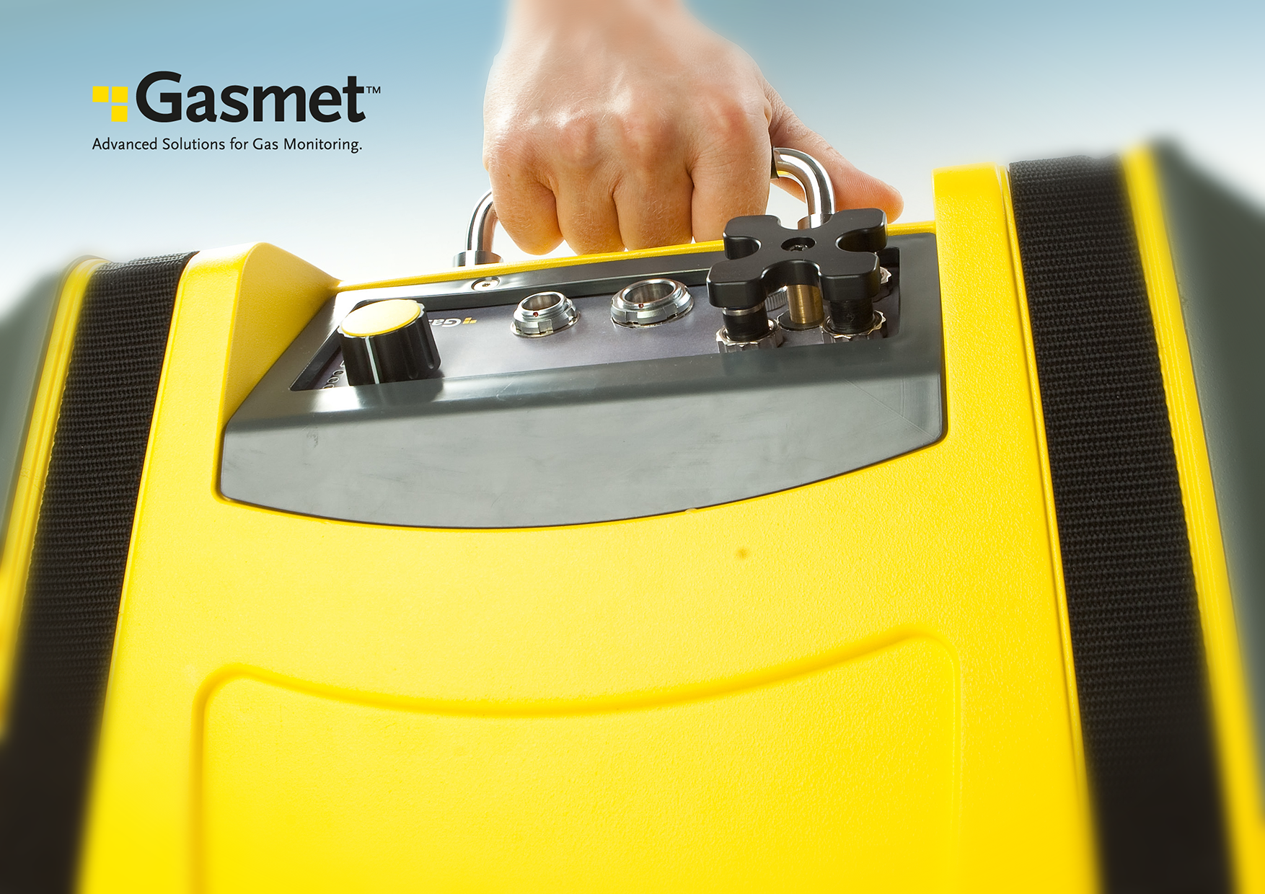
GASMET DX4040
Antti Heikkilä
Notes:
<szám>

Slide 2
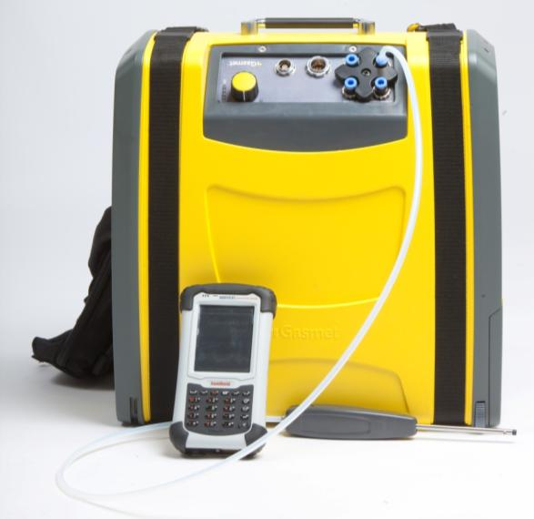
Complete redesign of the DX4040
New electronics
New handheld computer
New Calcmet Lite
New battery
New enclosure
New accessories
SAME INTERFEROMETER
SAME SAMPLE CELL
SAME DETCTOR

Slide 3
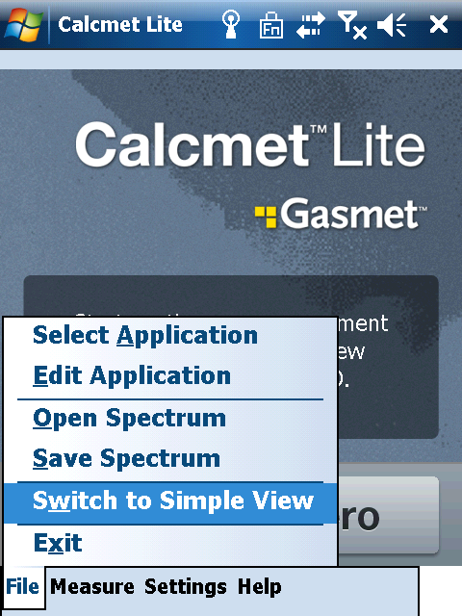
New mode of operation
Analysis is removed from the electronics board to the PDA
PDA stores several libraries
Each PDA library has up to 200 gases
PDA can analyse up to 50 gases
Libraries can be changed easily
Gases can be added and removed from analysis easily
Limited editing of analysis settings also possible
Analyser’s role more similar to traditional Gasmet DX4000, CX4000 models

Slide 4
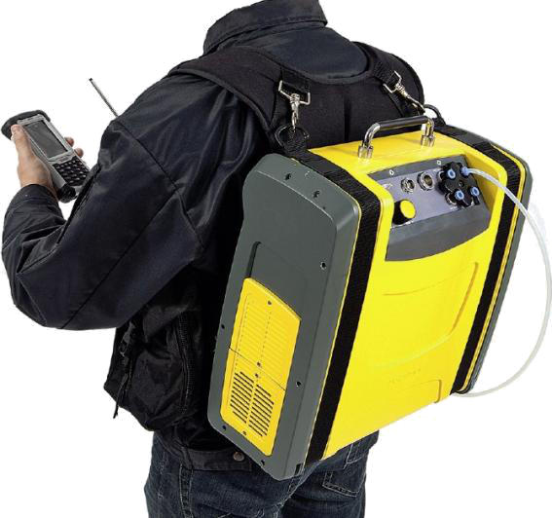
New Enclosure
Designed both for tabletop and backpack operation
Battery completely inside the enclosure
Tilted front panel for easier operation
Polyurethane plastic, tough and chemical resistant
Copper paint on inside ensures electromagnetic shielding and grounding
Improved carrying harness and shoulder strap
Notes:
<szám>

Slide 5
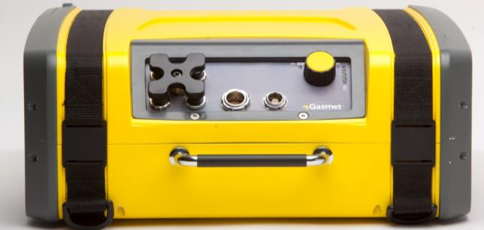
New front panel
Easy to use selector switch with 3 positions
Bluetooth ON
OFF
Serial ON
Battery charge indicator
Battery can be charged in place
Analyzer will run on 115/230 VAC with battery in place
Accessible gas connectors
Innovative connector cover plate

Slide 6
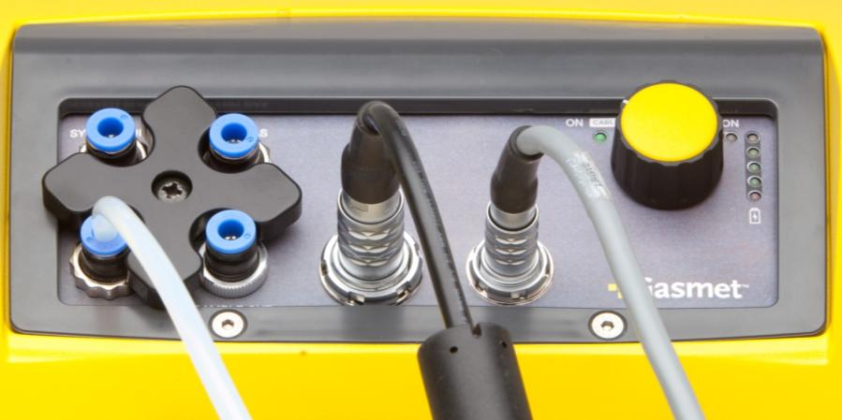
New front panel
Battery indicator
Red < 15%
Flashing LEDs indicate malfunction
Quick fittings
Sample in
Sample out
Zero + Span in
Interf. purge
Power plug
Charges battery while powering DX4040 with 115/230 VAC
Serial port
Cable terminates in standard RS-232 conncector
USB converter can be used
Power switch
GREEN – RS232
NO LIGHT – off
BLUE – bluetooth

Slide 7
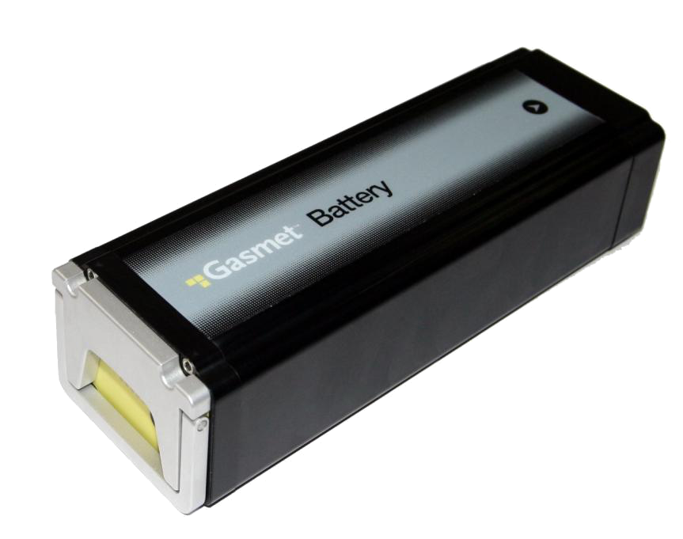
New Battery
11.25 VDC Lithium Ion battery
13.6 Ampere-hour capacity (150 Watt continuous discharge for one hour)
Smart Battery Standard – charge indicator LED’s on the battery and further diagnostics via USB from the charger
Battery can be charged inside the analyzer as in laptop computers

Slide 8
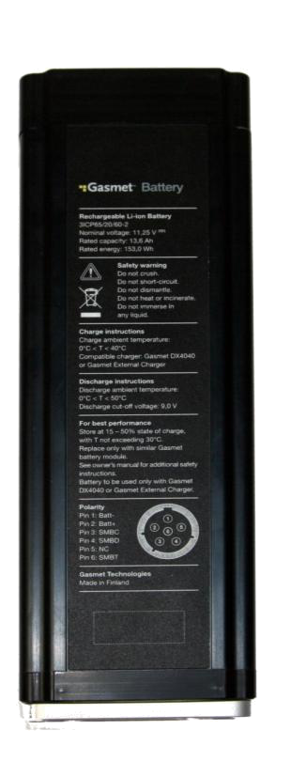
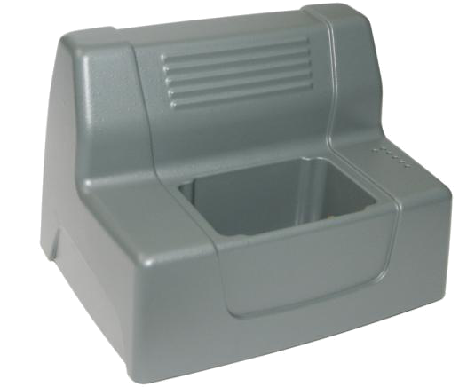
New Battery
Desktop charger available
Diagnostics available in Calcmet Service mode via USB connector on desktop charger:
% of charge
Estimated remaining charge time
Battery voltage
Battery temperature
Charge / discharge cycle counter

Slide 9
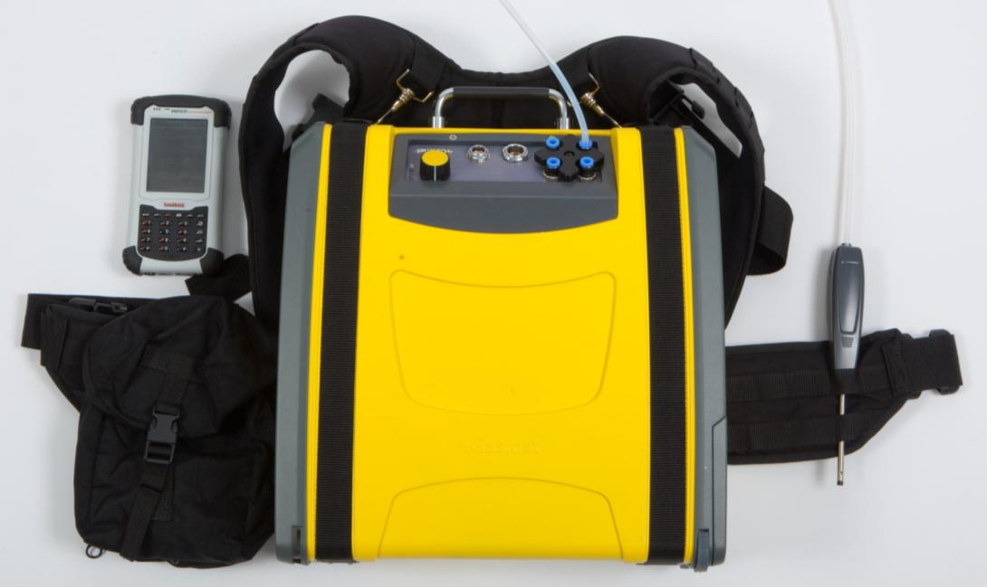
New accessories
Carrying harness
Easier to attach and remove
More comfortable to carry
Probe
Less weight
Better grip
Extension tube possible with Swagelok 6 mm fitting

Slide 10
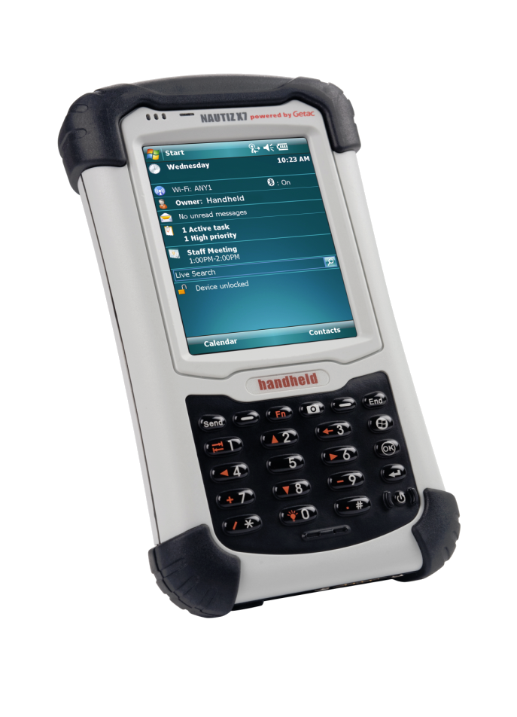
New PDA
NAUTIZ X7
IP65, shockproof
806Mhz processor
128Mb/4Gb memory
3G/HSDPA and Wlan networking
Bluetooth and RS-232 communications
Built-in Camera and GPS

Slide 11
New Calcmet Lite
Calcmet Lite has been completely revised to include analysis of recorded spectra
New PDA with more memory, faster processor and bigger screen enables other improvements as well:
Better spectrum draw routine
Sending results and spectrum files via WLAN or 3G modem (the PDA acts as a cell phone)
Integrated GPS with coordinates saved in results file

Slide 12
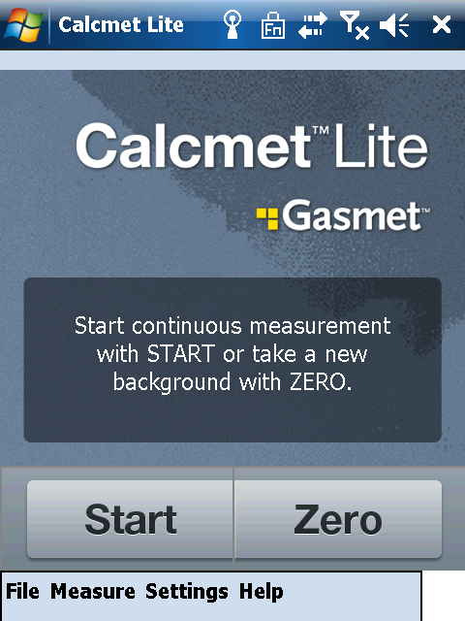
Calcmet Lite v2.0 features
On screen guidance
Big buttons for
START
STOP
ZERO

Slide 13
Calcmet Lite v2.0 features
On screen guidance during measurement

Slide 14
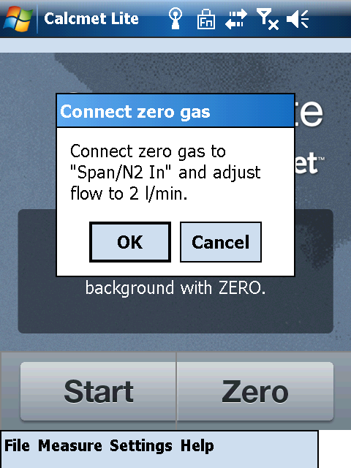
Calcmet Lite v2.0 features
Common procedures like zeroing are made easier
Minimal training required for basic operation

Slide 15
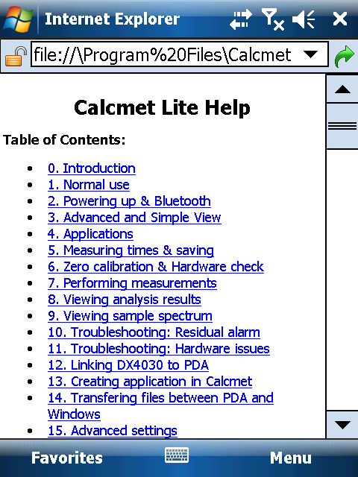
Calcmet Lite v2.0 features
Built in help file (opens in web browser)
Contains same information as DX4030 quick reference cards

Slide 16
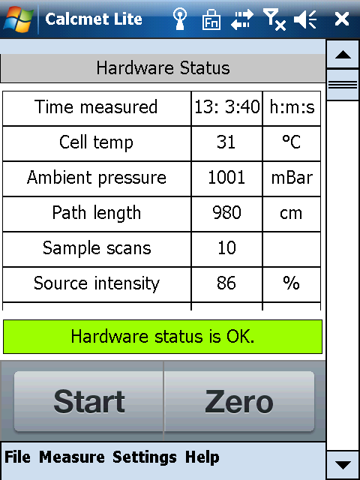
Calcmet Lite v2.0 features
Hardware status contains OK / ERROR message listing the parameters, which are outside accepted ranges

Slide 17
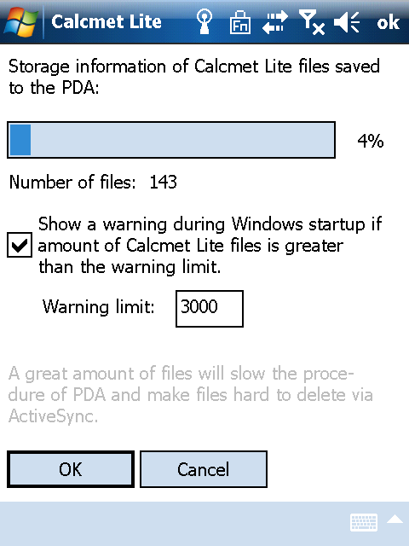
Calcmet Lite v2.0 features
Built-in protection against low memory card space problems
Completely filling the system memory requires low-level reboot, losing all data

Slide 18
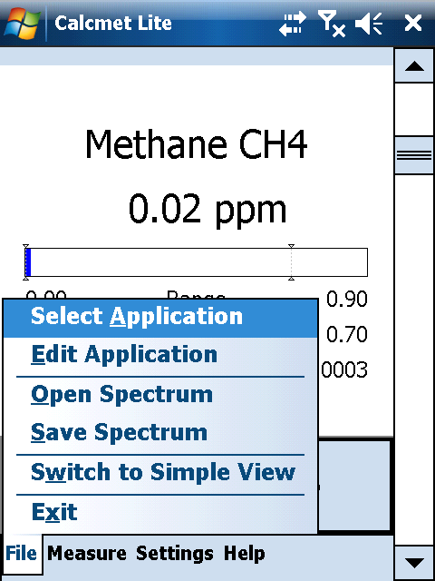
Calcmet Lite v2.0 Analysis settings
Selecting an application

Slide 19
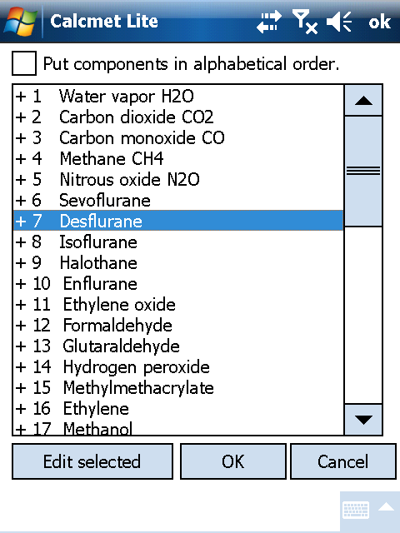
Calcmet Lite v2.0 Analysis settings
Enabling and disabling components

Slide 20
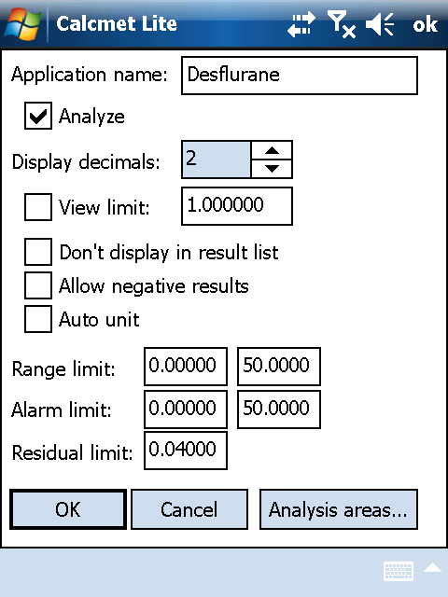
Calcmet Lite v2.0 Analysis settings
Editing component specific settings
All settings can be edited on PDA
Due to limited spectrum display options actual application development is best made with full version of Calcmet for Windows

Slide 21
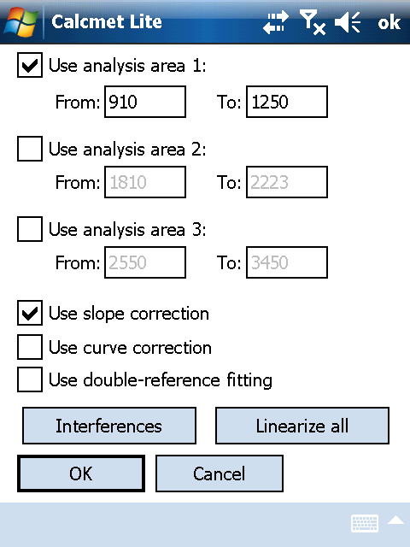
Calcmet Lite v2.0 Analysis settings
Editing component specific settings
All settings can be edited on PDA
Due to limited spectrum display options actual application development is best made with full version of Calcmet for Windows

Slide 22
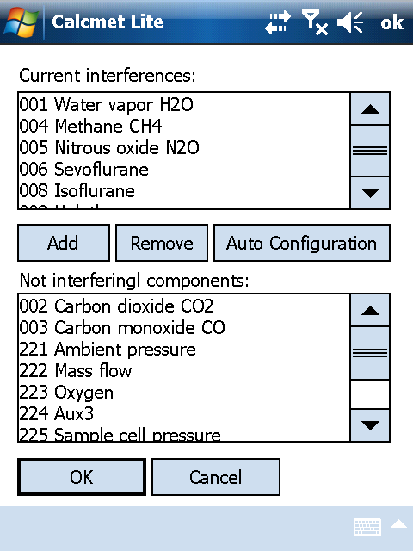
Calcmet Lite v2.0 Analysis settings
Editing component specific settings
All settings can be edited on PDA
Due to limited spectrum display options actual application development is best made with full version of Calcmet for Windows

Slide 23
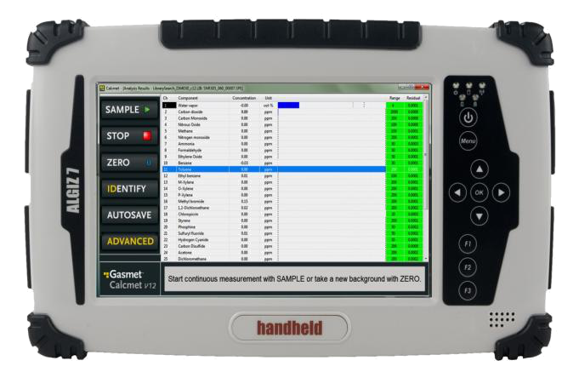
Using DX4040 with Calcmet for Windows
Calcmet 4030 Standard software is no longer needed, Calcmet Lite performs same functions
Calcmet 4030 Pro software renamed Calcmet 4040 Pro remains
DX4040 cannot be run from Calcmet for Windows without serial number specific HASP key
New, improved simple mode, optimized for 7” tablet PC in Calcmet 12 (more in Calcmet presentation)
New, improved simple mode, optimized for 7” tablet PC in Calcmet 12 (more in Calcmet presentation)

Slide 24
Comparison with DX4030
 | DX4030 | DX4040
Analysis | Within analyzer DSP board | In new version of Calcmet Lite
Application file | Special text files (2) for DSP + LIB file for PDA | Standard Calcmet LIB file
Changing applications | Only by uploading new files to analyzer with Calcmet Standard or Pro key | Application can be changed and edited directly in PDA
# of analysed gases | Up to 25 | Up to 25
Battery charging | In external charger only, no charge indicator | Inside analyzer or in external charger
Battery status | Not available | Indicators on analyzer, charger and battery + full diagnostics in Calcmet Service mode
GPS support | no | Yes
Using full version of Calcmet | Requires Calcmet Pro key | Requires Calcmet Pro key

Slide 25
Availability and Pricing
Orders accepted now
First deliveries in December
Base price will be slightly higher than DX4030
Better PDA and added features compensate for this
DX4040 without any extras is more powerful than DX4030 with Calcmet 4030 Standard software and HASP key
Calcmet 4040 Pro version priced in the same way as Calcmet 4030 Pro
Price lists will be sent shortly after the meeting

Slide 26
Availability of DX4030
DX4030 will not be discontinued
Availability in 2012 is guaranteed
Ongoing public tenders and other long-term projects with the DX4030 will not be affected
The need for DX4030 after 2012 will be assessed next year

Slide 27
Notes:
<szám>

